Slide 1

Revised Los Angeles County Countywide Siting Element
Los Angeles County Solid Waste Management Committee/
Integrated Waste Management Task Force
February 18, 2016
Presented by: Joe Bartolata

Slide 2
Background
Public Works released the Initial Study and Notice of Preparation (NOP) of the Draft Environmental Impact Report (Draft EIR) for the CSE
Six public scoping meetings were held and comments were received from the Task Force and nine responsible agencies.
The CSE was revised to reflect recent changes in state law and update the base year.
Public Works suspended the preparation of the Draft EIR until revision was completed.

Slide 3
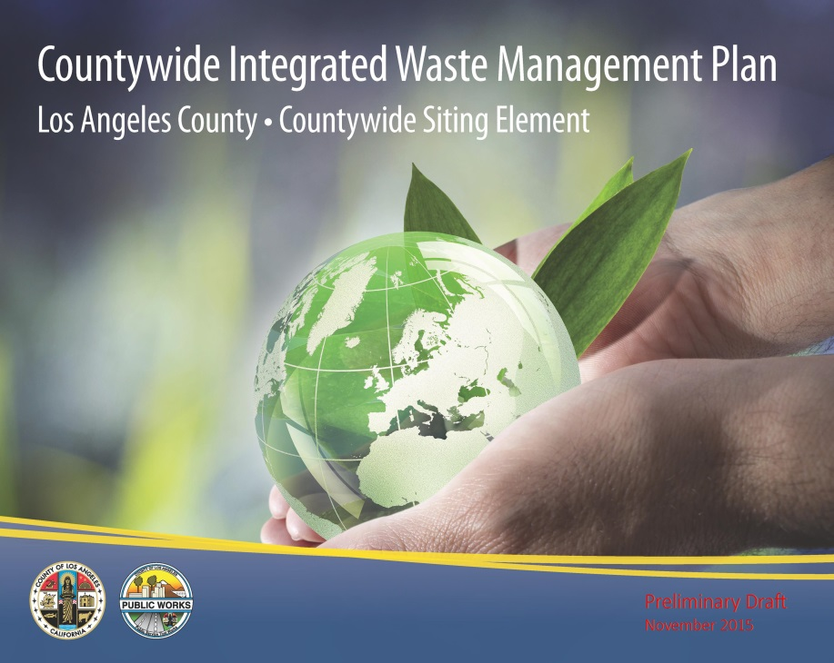
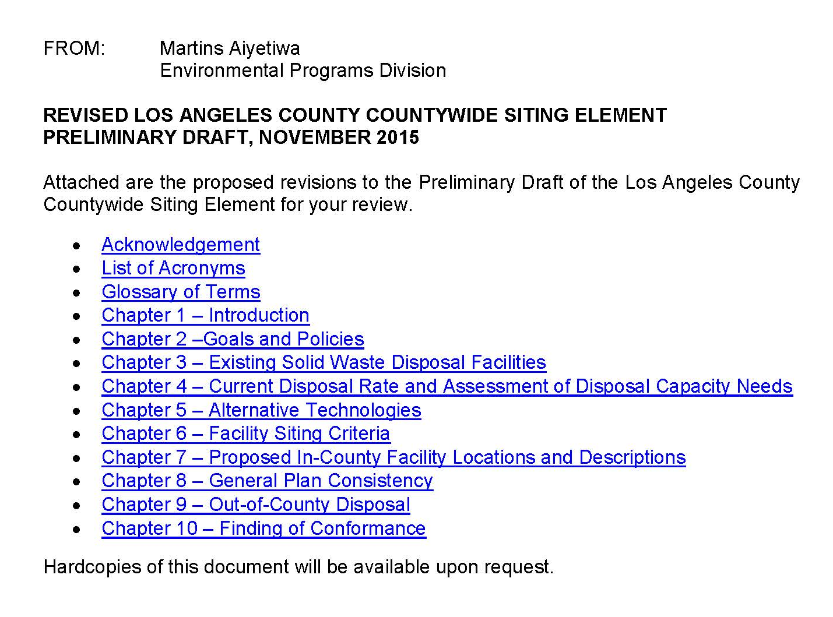
Background

Slide 4
Key Revisions
Updated the base year of 2014
Disposal data and solid waste facilities information
Considered the impacts of current legislation:
Mandatory commercial recycling (AB 341),
Diversion of organic waste from landfills through organics recycling programs (AB 1826),
Prohibition on local disposal limits (AB 845),
Engineered Municipal Solid Waste (EMSW) conversion and facilities (AB 1126).
Revised some definitions of terms accordingly based on current legislation.

Slide 5

Chapter Revisions
Chapter 2 – Goals and Policies
Updated some of the goals and policies to reflect current regulatory changes such as the following:
Revised Goal No. 4 to include the recycling of organic materials from the waste stream;
Added Policy No. 4.3 for developing a countywide organics management plan;
Revised Policy No. 4.5 regarding the use of green waste as alternative daily cover; and
Added Policy No. 5.1 for developing a regional operational area mass debris management plan.

Slide 6
Chapter Revisions
Chapter 4 – Current Disposal Rate and Assessment of Disposal Capacity Needs
Updated Scenario Analysis:
Existing in-County solid waste disposal facilities
Increase in diversion rate
Potential expansions of existing in-County landfills
Potential alternative technology capacity
Out-of-County disposal
Considered the implications of CalRecycle’s “State of Disposal in California” and “State of Recycling in California” reports on the Countywide diversion and disposal quantities.

Slide 7
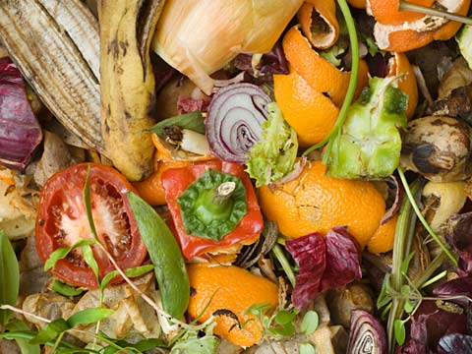
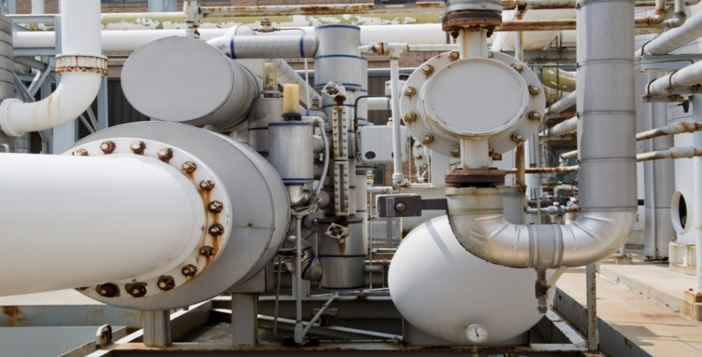

Chapter Revisions
Chapter 5 – Alternative Technologies
Included information on SB 498 (Biomass Conversion)
Provided update and clarification on the alternative technology processes.
Included the City of LA’s “Solid Waste Integrated Resource Plan (SWIRP)”

Slide 8
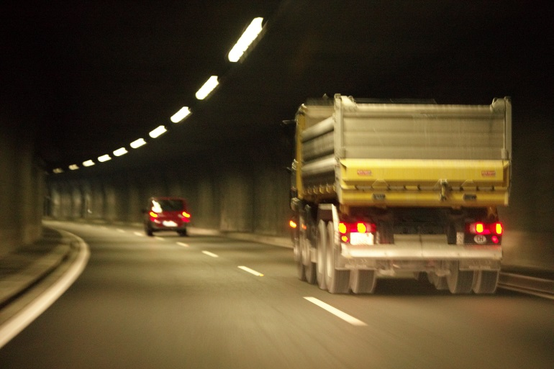
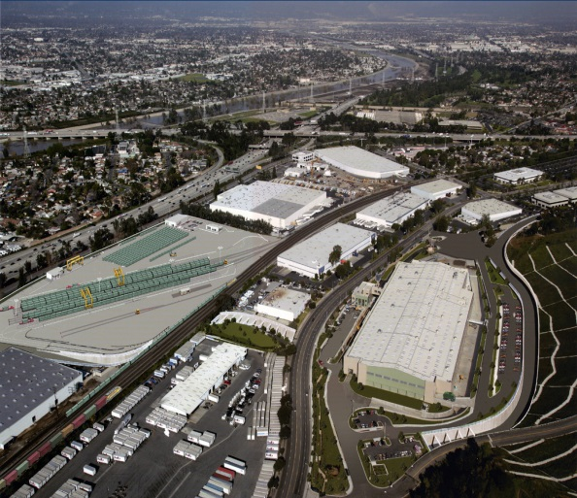
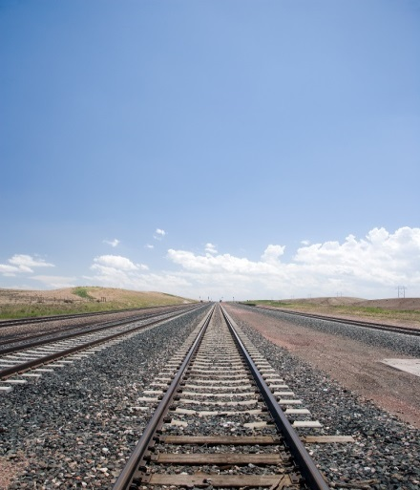
Chapter Revisions
Chapter 9 – Out-of-County Disposal
Removed Eagle Mountain Landfill information

Slide 9
Next Steps
Consideration of the Prelim Draft CSE from the Task Force
Resume the preparation of the Draft EIR
Release the Prelim Draft CSE and Draft EIR for public, cities, and agency review

Slide 10
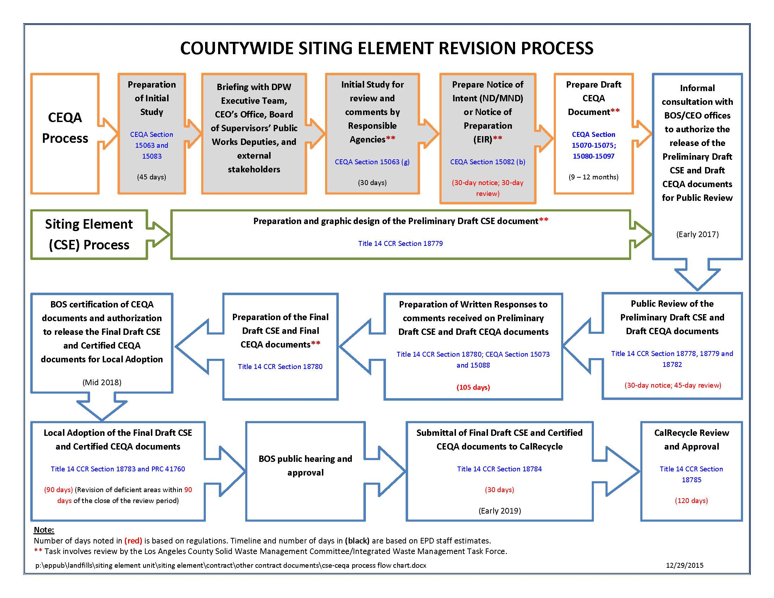

Slide 11
Thank you.

